Slide 1
Making your audio and video files searchable using Amazon Transcribe and Amazon Kendra
Organizations across entertainment, education, and advertising industries increasingly use media to engage with their audiences. However thousands of personnel hours are often spent tagging, labeling, transcribing, and cataloging media assets to make their content discoverable
This open source solution is a search application that allows users to query the content repository and play the relevant sections of original media files returned in results
The solution is implemented as an Amazon Kendra custom data source connector specially designed to crawl, transcribe, time-mark and index media (audio and video) files, along with an enhanced Kendra search application
Deliverables
Reusable open source no-code solution published in GitHub with a CloudFormation template for 1-click launch blog post
Blog post to introduce the solution and its purpose with a tutorial for its installation, use and a look ‘under the hood’ explaining how it’s architected

Slide 2
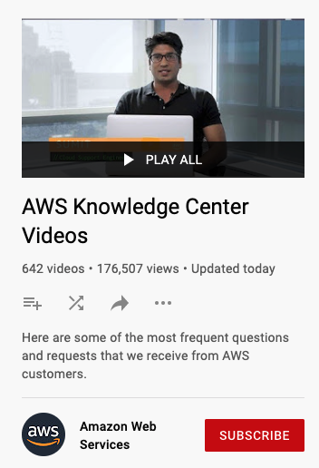
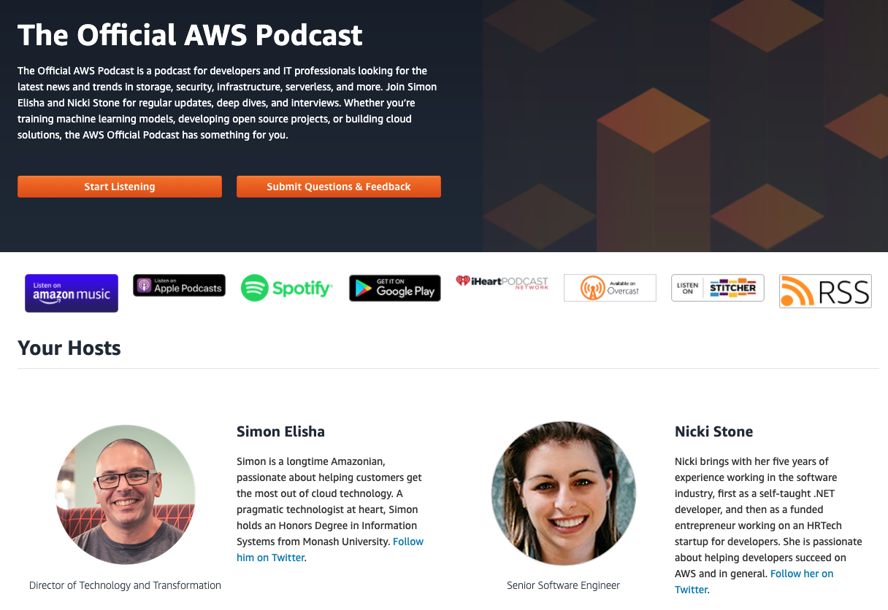
Demo Content

Slide 3









EventBridge Schedule or Trigger Event
EventBridge Transcribe Job Complete Event
Amazon Transcribe
(Transcription jobs)
User Provided S3 Bucket with
Media Files
Lambda to start custom datasource sync, crawl S3 bucket and start Transcription jobs
Lambda to extract time marked text, index the text, and stop datasource sync when all jobs are complete
Amazon Kendra Index
with Custom datasource configured
Users using Web App from Browser to run queries
DynamoDB Table to keep track of files, jobs, state

